Slide 1

Image Classification

Slide 2
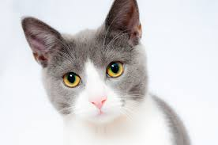

What is Image Classification?
Image classification is the process in which an image is matched to a specific word.
You do this all the time with your eyes and brain just looking around at the world!
CAT

Slide 3
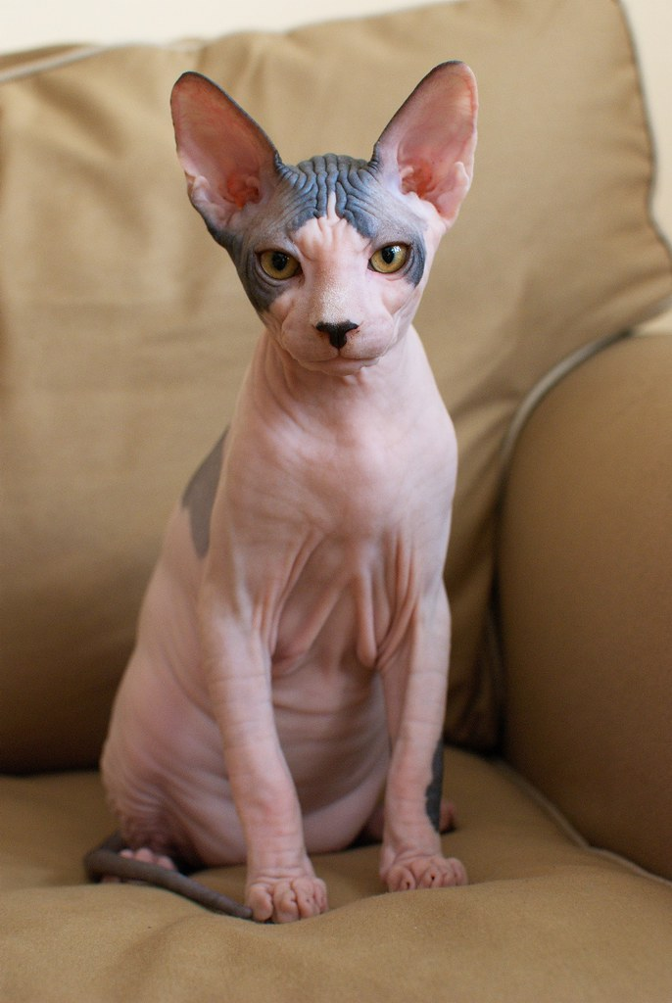
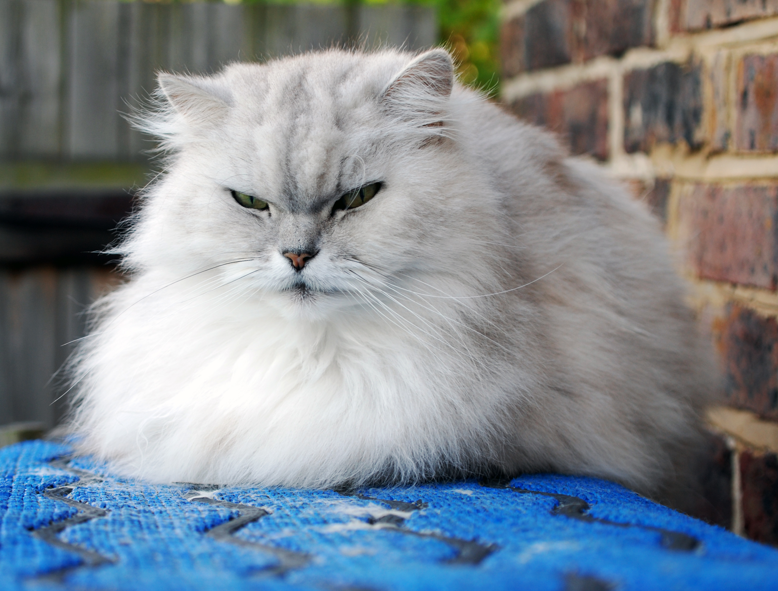
Why is this hard for machines?
Machines don’t have systems as complex as our brains.
We can see that these images are both cats, but they look so different it would be hard for a machine to figure out.

Slide 4
Image Recognition using Machine Learning
Because there are so many parts of an image to consider, a machine needs to be able to learn, just like us, to correctly classify an image.
To do this it uses machine learning, a method that lets the machine learn from images.

Slide 5
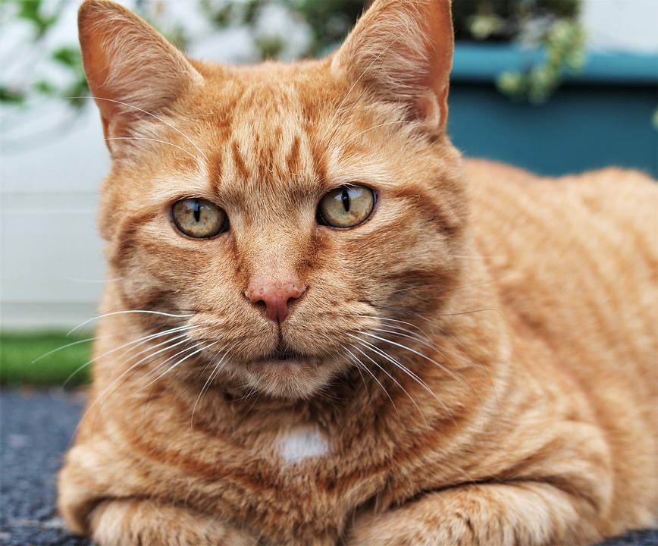
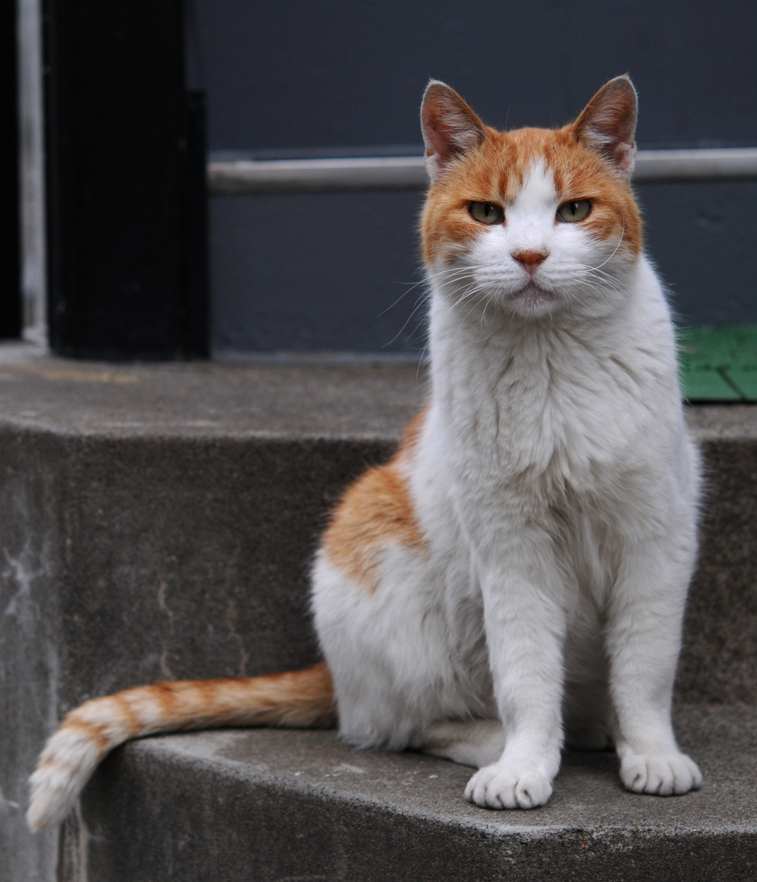
Testing and Training
To teach a machine to recognize images, you give it training examples first so it can learn what certain images are supposed to look like.
Then, you can give it testing examples to see if it is correct!
TRAINING
TESTING
“Now, tell me what this image is.”
“This is a cat. Learn to classify this as a cat.”

Slide 6
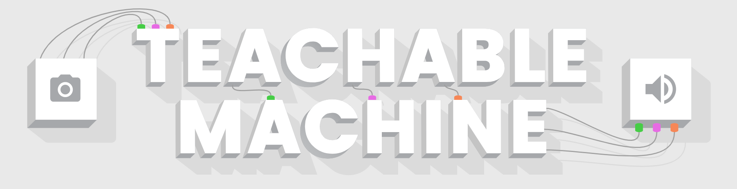
Let’s Try it!
Click on the Teachable Machine to get started.

